Slide 1

JBIG
SEMINAR
딥러닝 팀

Slide 2
JBIG
CONTENTS
SEMINAR
01. Experiment Result
02. Additional Analysis Technique (CAM)
03. Appendix

Slide 3
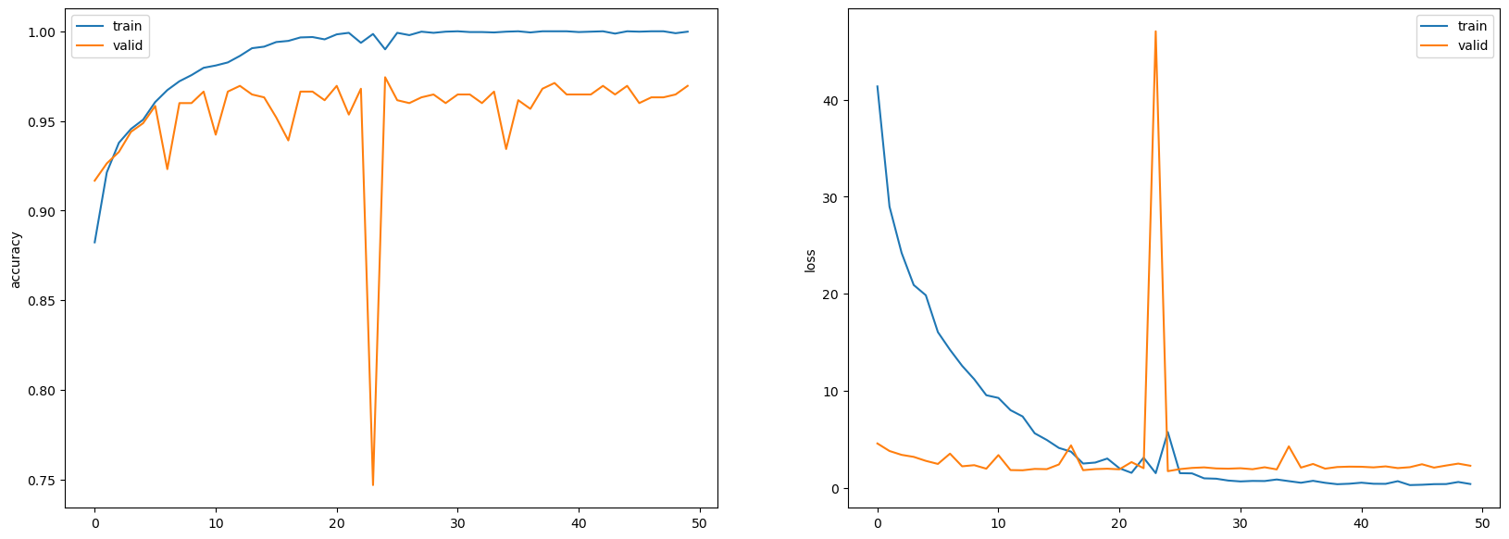
01
Experiment Result
SEMINAR
ResNet 18 Result
Hyperparameter
Learning rate : 0.1 (1/10 decrease)
Activation Function : SGD
Weight decay : 0.0001
Epoch : 50

Slide 4
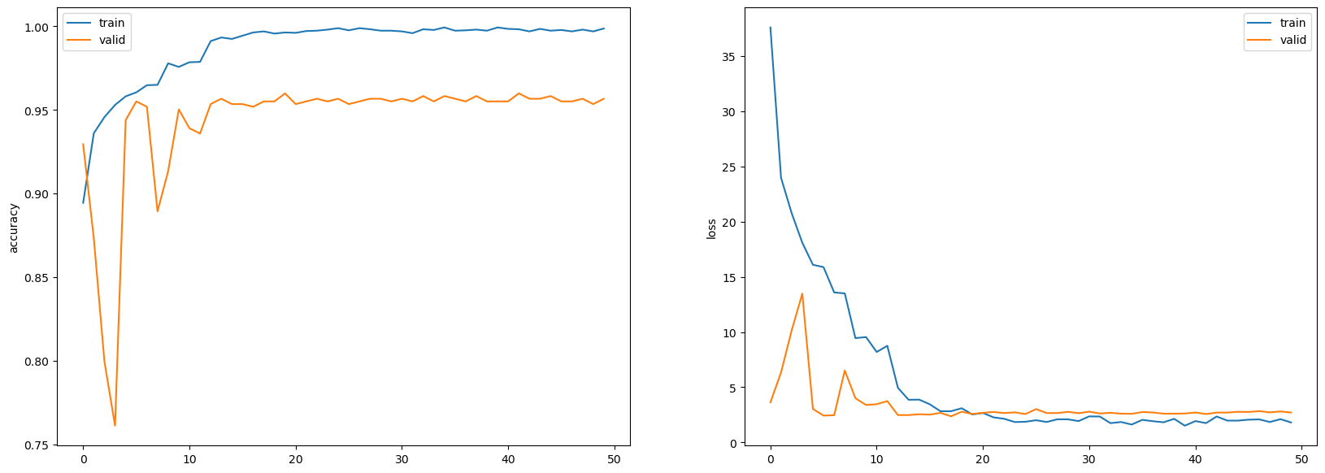
01
Experiment Result
SEMINAR
ResNet 34 Result
Hyperparameter
Learning rate : 0.1 (1/10 decrease)
Activation Function : SGD
Weight decay : 0.0001
Epoch : 50

Slide 5
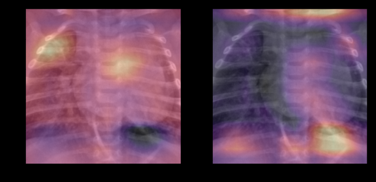
02
Experiment Result
SEMINAR
ResNet 18 CAM
Label : Pneumonia
Label : Normal

Slide 6
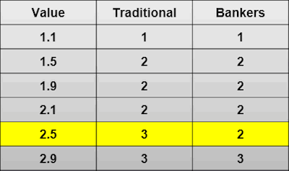
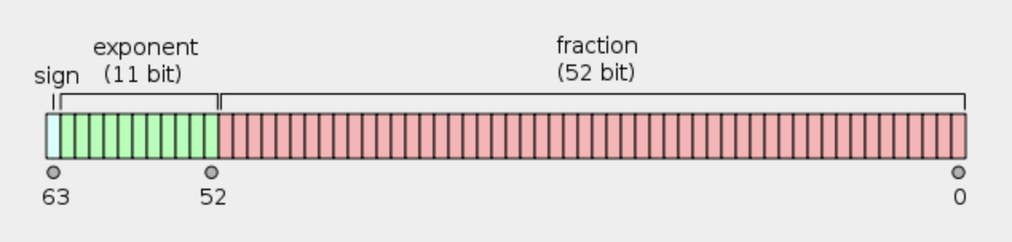
03
Appendix
SEMINAR
Gaussian Rounding
Prevent overflow

Slide 7
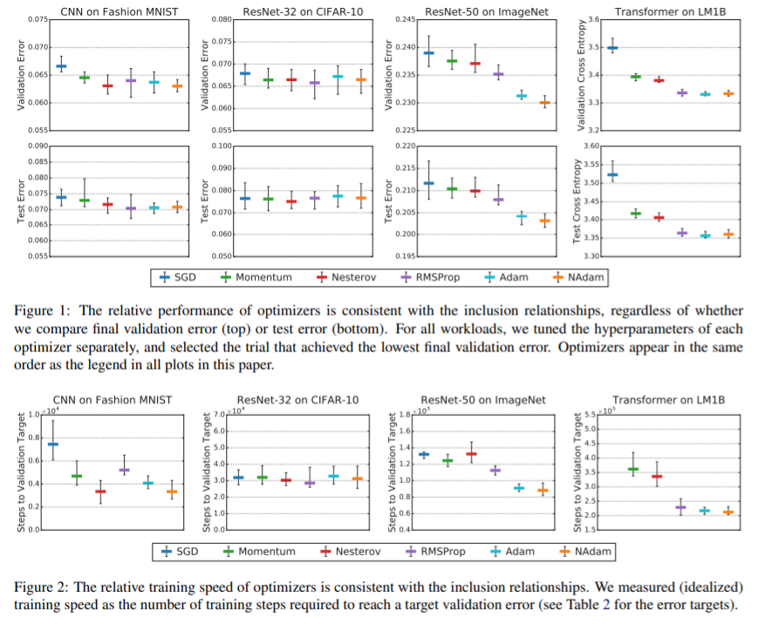
03
Appendix
SEMINAR
Activation Select : SGD vs Adam
Paper

Slide 8
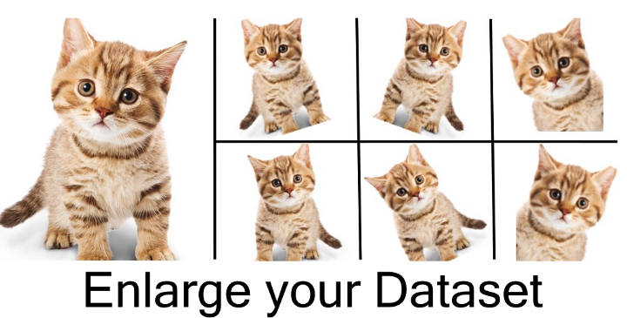
03
Appendix
SEMINAR
Next Step, Data Augmentation

Slide 9
Q&A
Thank you

